Slide 1
Acrylate Safety Training
make 717
May 2022

Slide 2
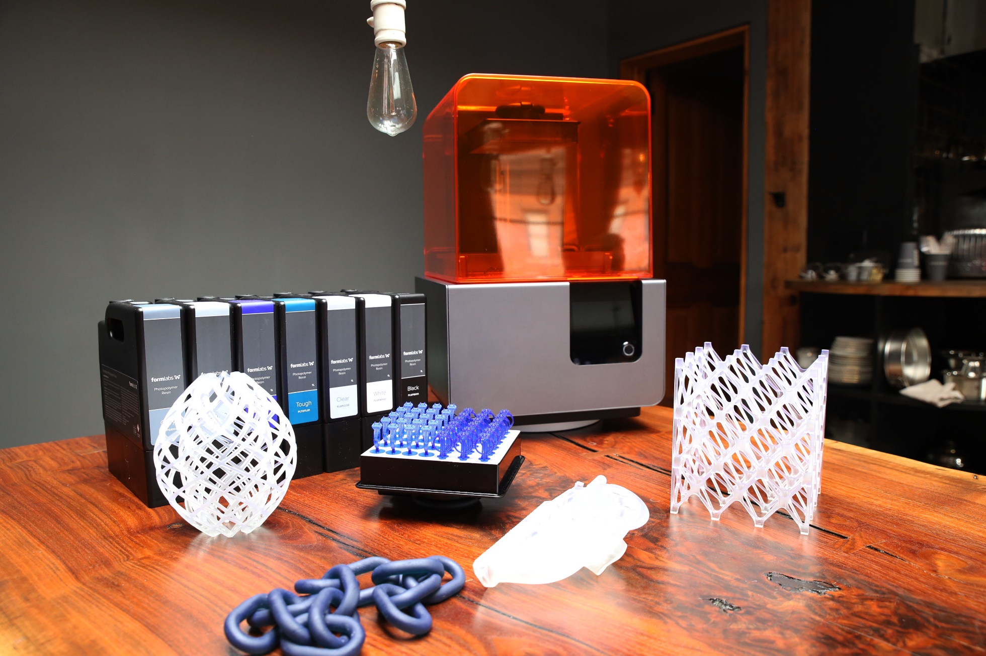

Slide 3
Outline
make 717 general safety
Hazard v Risk
Acrylates 101
SDS overview
Acrylate Safe Use
UV and Laser safety
IPA safe handling
Resources
Appendix:
Detailed SDS review

Slide 4
make 717 Emergency Procedures
Please follow the list of contact numbers and if necessary, enter these numbers into your phone.
Emergency- 911
TSCT Security-(717)606‐1564
PA State Police-(717)299‐7727

Slide 5
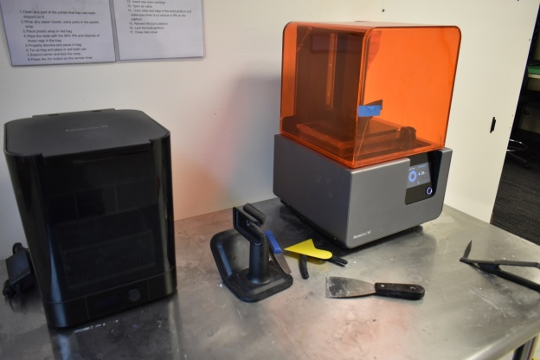
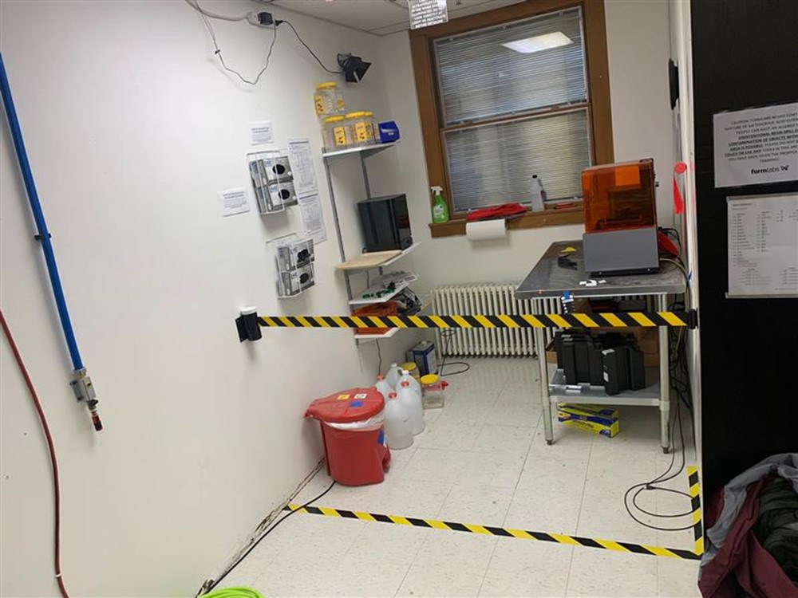
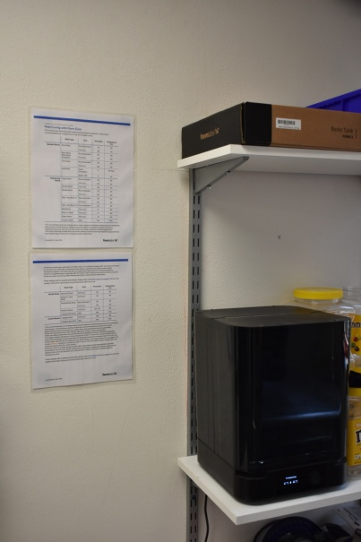
Formlabs area
As of May 2022

Slide 6
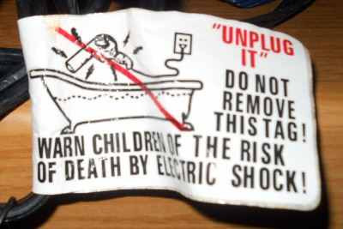
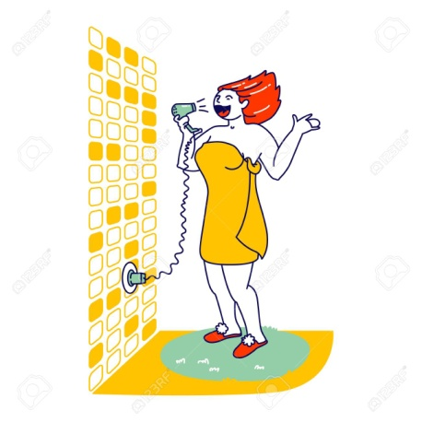
Hazard v Risk
“Hazard” is all the things that could go wrong….
Risk is what is likely to go wrong
Severity, frequency, and probability are factors
Example: Blow dryers + water
There are significant potential hazards associated with the Formlabs, but in general the risks are low.
Hazard statement
Low Risk
High Risk

Slide 7
Why is this training important?
The Formlabs printer uses acrylate-based resins.
Although Formlabs has done a very good job of minimizing the risks from acrylate exposure, make 717 has decided that our members need to have some basic training before using the printer.
Additional information is available from Formlabs: https://support.Formlabs.com/s/article/Safety-form2?language=en_US

Slide 8
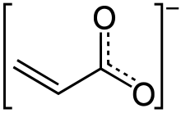
Acrylates General Information
“Acrylates” are a family of polymers.
Acrylate ions are highly reactive.
This reactivity means that they can react with YOU!
So there are special safety considerations for acrylates and they must be treated with care and respect.
Prior to any interactions with acrylates, you must become familiar with the hazards, risks and safety considerations.
Acrylate ion

Slide 9
The SDS
SDS = Safety Data Sheet
formerly known as MSDS, Materials Safety Data Sheet
Shares the basic information about each chemical or compound, including:
Basic properties
Physical, health and environmental hazards
Protective measures
Safety precautions for handling, storing, etc.
https://www.osha.gov/Publications/OSHA3514.html
The SDS is the comprehensive list of hazards

Slide 10
Acrylate Safety – Topics Covered
The SDS – a list of the hazards
Proper Handling, Safety Gear and Personal Hygiene – reduces risk
Hazards
Eye Contact
Respiratory irritation
Skin irritation (dermatitis)
Skin sensitization
Personal Protective Equipment –reduces risk
Storage and Disposal – reduces risk

Slide 11
SDS Implications
Acrylates such as the Formlabs resin need special precautions
They are irritants to the skin and lungs
They can cause chemical sensitization – permanent health impact
They can’t just be tossed in the trash
Contamination is a monumental pain because everything must be collected, cured and disposed of separately
Formlabs has designed a system that should minimize the risks, but care must be used!
This is not PLA. Misuse of the resin or ignoring safety requirements will result in losing privileges at make 717!

Slide 12
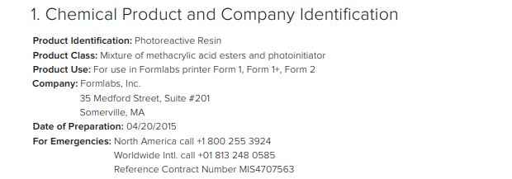
SDS for Formlabs resins: Sect 1, Chemical Name and Maker
The Formlabs resin materials are “photoreactive” – they start to have a chemical reaction when exposed to light
Methacrylic acid esters – therefore they must be treated as Acrylates
Notes:
This is a high level review of the safety data sheet for Formlabs resin and its implications for your safety.
More detailed reviews of each section of this SDS are included in the Appendix

Slide 13
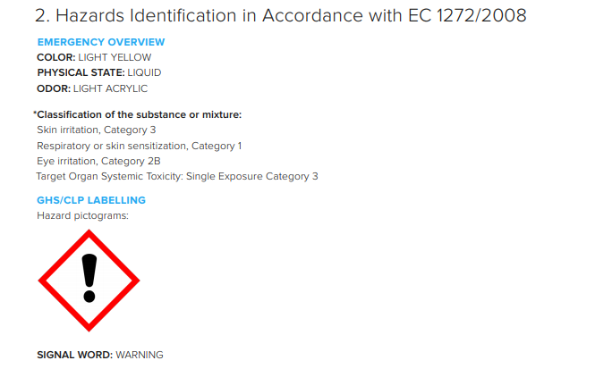
SDS Sect 2: List of Hazards
Class 1 is more dangerous than Class 2…
This part of the SDS summarizes the hazards :
Skin irritant
Skin or respiratory sensitizer (i.e., exposure can make you allergic – think peanuts)
Eye irritant

Slide 14
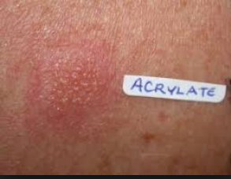
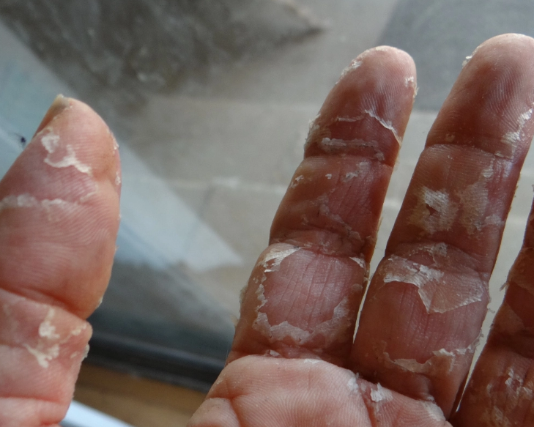
Skin irritation
Minor reaction
Risks are determined by your behavior and your personal body chemistry
Severe reaction

Slide 15
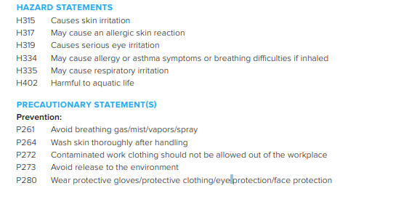
SDS Sect 2: List of Hazards, con’t
More details about Specific Hazards and how to handle safely:
Skin irritant = wear gloves, wash after handling
Wear eye and/or face protection
Special containment to avoid releasing into the environment
Contaminated clothing shouldn’t leave the work area!!! This is to limit accidental contamination to other surfaces.
This is NOT PLA!!!

Slide 16
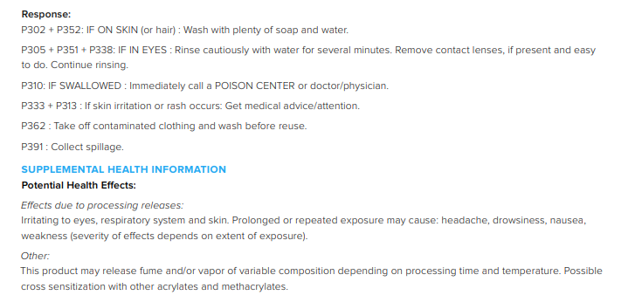
SDS Sect 2: List of Hazards, con’t
More details about How to safely handle:
Wash well
Seek medical attention if a rash forms
Collect any stray spills and contaminated goods, including clothing
Other health effects
Headaches, nausea, etc.

Slide 17
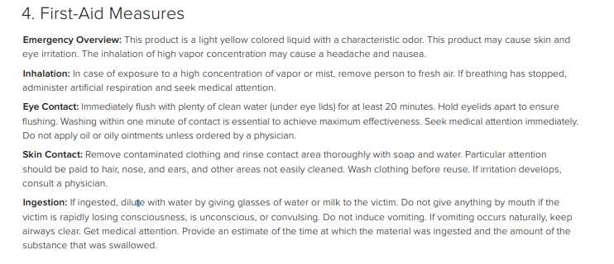
SDS Sect 4: First Aid
Section 4 gives the First Aid information. You should always read this (consider reading it first!)
What to do in case of an incident: inhalation, resin in eye, resin on skin, ingestion

Slide 18
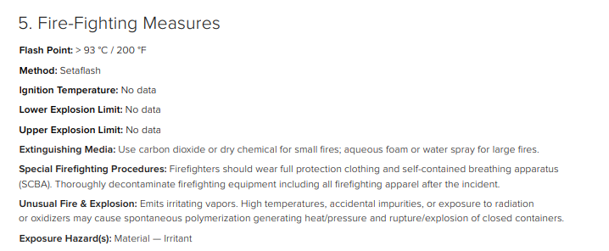
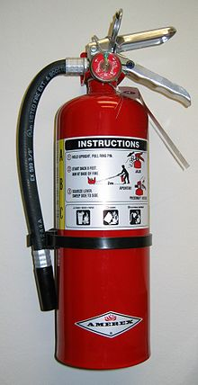
SDS Sect 5: Fire Fighting
Section 5 gives the Fire Fighting information.
Carbon Dioxide or dry chemical fire extinguisher needed
Use the extinguishers provided in the printer room – they have been selected for use with these materials

Slide 19
Fire Extinguisher

Slide 20
SDS Sect 6: Spills
Section 6 gives the info on what to do if you have Spill. Read and understand this!!
DO NOT flush resin down the drain!!! (causes issues in the water system…)
Need a dedicated trash container for anything that gets contaminated! Use the red one provided.

Slide 21
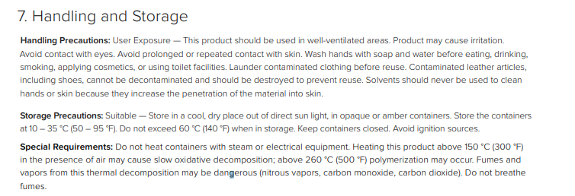
SDS Sect 7: Handling and Storage
Section 7 gives the info on Handling and Storage
Use in a well ventilated area
Contaminated clothes with liquid resin can be washed (by themselves), but soft leather goods are supposed to be destroyed. However, to limit exposure to others, make 717 suggests the clothes to be cured or disposed of before leaving the area if at all possible.
Smaller “drips” can be cured under the UV Lamp at make (24 hrs is usually sufficient to fully cure; semi-cured in 2-3 hours, followed by several days in direct sun). Limit taking uncured resin outside the dedicated area.
For larger amounts of contamination:
Isolate by bagging the items separately.
Layers are suggested.
Consider keeping a change of clothes at make or in your car if you will be doing maintenance on the printer.
This is NOT PLA!!!

Slide 22
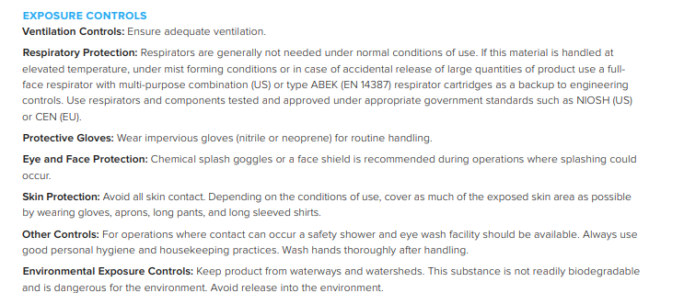
SDS Sect 8: Exposure and PPE
Section 8 Exposure Controls
Well ventilated area
Nitrile or Neoprene gloves for handling - provided
Splash goggles - provided
Wear long sleeves – consider an old shirt or disposable apron, esp. when pouring resin, performing maintenance or just because your middle name isn’t “Grace”. But consider whether they are likely to brush against the resin……

Slide 23
SDS Sect 13: Disposal
Section 13 – Disposal
Use a licensed professional disposal service to dispose of large amounts the uncured resin!!!!
This is expensive to do, so please don’t waste, don’t spill. And don’t take it home and dispose of that way!
The good news – we can take it to the LCWMA transfer station, but only in small quantities
Don’t put into the drains!
Contaminated packaging, etc.: expose to light to cure and then dispose

Slide 24
The key to working with the Formlabs
Avoid CONTACT!
COVER yourself and surfaces
CONTAIN the resin
CURE the rest
And respect the built in safe guards!

Slide 25
Acrylate Safety Summary
Hazards
Skin irritation & sensitization
Eye
Respiratory
Wear Appropriate Personal Protective Equipment.
Follow Good Personal Hygiene Practices.
Store and Dispose Correctly
Always Check SDS.
Avoid contact with resin: COVER yourself and surfaces, CURE resin, CONTAIN the rest.

Slide 26
Personal Protective Equipment (PPE)
The PPE needs for using Formlabs’ resins are very specific:
Wear nitrile or neoprene gloves.
Nitrile gloves in various sizes are available in the area.
If your gloves rip, put on new ones!
Use safety glasses/goggles, preferably with UV protection.
Always wear eye protection when pouring resin.
UV Splash goggles (2 pair) are provided and should be kept in the Formlabs work area.
AVOID contamination of clothing. (Hint – don’t wear anything you really care about.)
No open toed shoes
Impervious shoes are recommended. AVOID mesh, canvas, suede/super soft leather if possible.
Long sleeves and pants are recommended to avoid skin contact, esp. when pouring resin, performing maintenance or if you are uncomfortable. But consider the risk with the specific task.
Long hair should be tied back, esp. if pouring resin or performing maintenance.
Always Review the Safety Data Sheets if you are uncertain of the recommended PPE

Slide 27
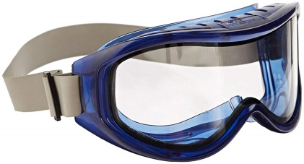
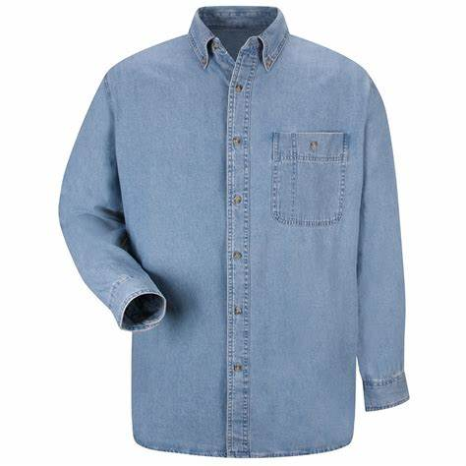
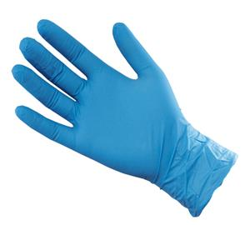
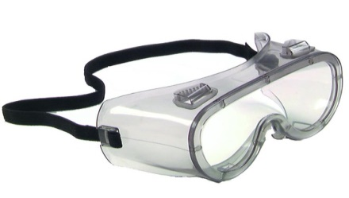
Safety Gear (PPE) - Cover
UV + splash resistant
Nitrile Gloves
(blue or black)
Long Sleeves
Eye Protection
Highly recommended for maintenance and pouring resin
Required
Recommended for regular use.
Required for maintenance and pouring resin.

Slide 28
Proper Handling
 | Approach
Only use resins in approved, signed spaces. | Contain
NEVER TOUCH UNCURED RESINS DIRECTLY!!! | Contain
ALWAYS wear nitrile or neoprene gloves. Double glove if you are allergic to either of these. | Cover
Wear eye protection when pouring resin | Cover
Consider wearing disposable, long sleeve clothes (i.e., something you don’t care about) | Cover
DO NOT touch your skin, clothes or surfaces with uncured resin. Be especially careful not to touch the table top area. Plastic wrap is provided to cover the table and ease in cleaning up any potential drops. | Cover
Remove your gloves and dispose of them before you touch the tabletop, a doorknob or other surface! Use the approved method for glove removal. | Contain
If any surfaces or clothing get contaminated with uncured resins, you need to wipe with IPA, throw them out, in a bag, in the acrylate-signed waste container. Not in the regular trash can!! | Contain
Fully cured resin can be thrown out in the regular trash | Cure
Formlabs has created a system that greatly reduces the risk of touching resin, but care must be used!

Slide 29
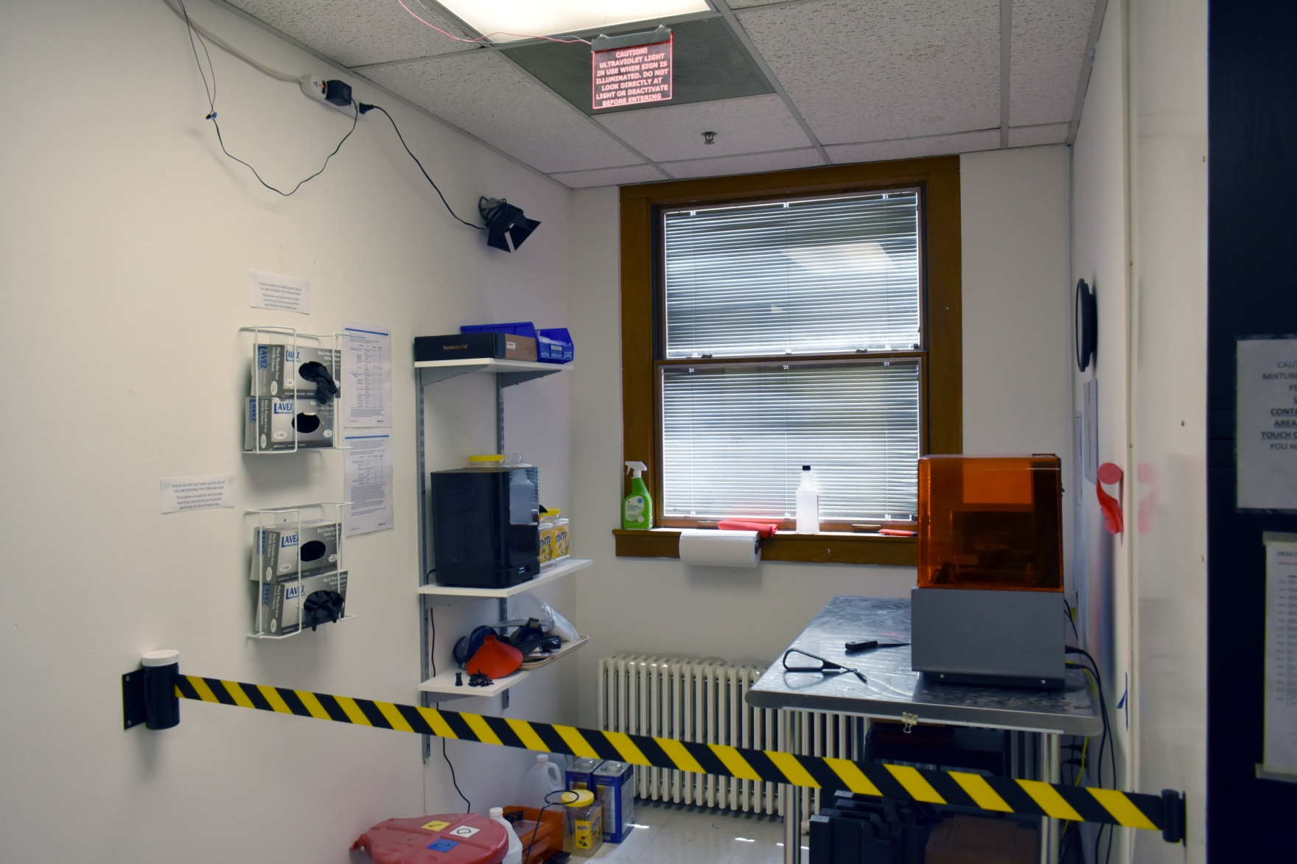
Gloves location

Slide 30
Gloves
make 717 is providing black gloves – the resin creates shiny spots that are easier to see than on the blue type…..

Slide 31
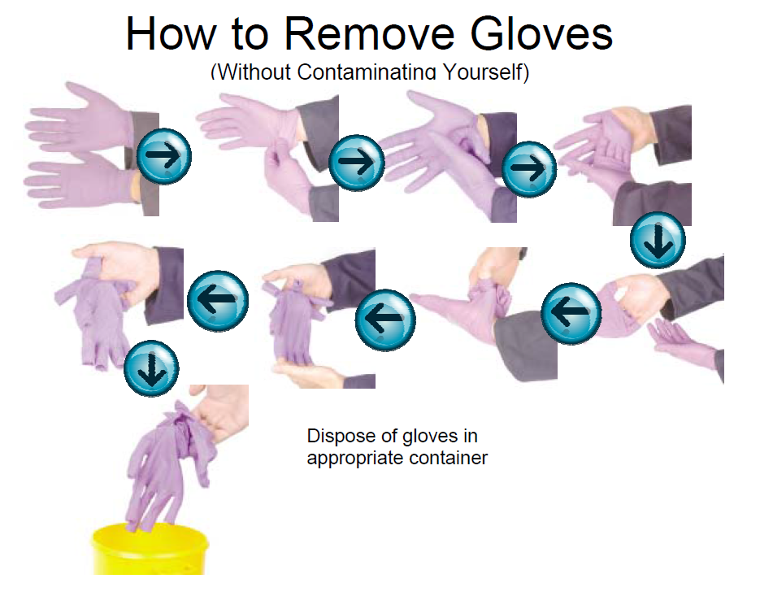
Safely Removing Gloves
Assume your gloves will be contaminated, so you don’t want to get any of the resin on the rest of you. Follow these directions to safely remove gloves. Practice this until you can do it without touching the outside of the gloves with any part of your body…..
https://www.youtube.com/watch?v=S4gyNAsPCbU
If you double glove, put the next size up over your first pair.

Slide 32
Personal Hygiene
DO NOT eat, drink or smoke in the tiled acrylate work area.
Avoid contact with surfaces/objects that may be contaminated with uncured resin. Prolonged exposure to the skin may result in irritation and sensitization.
Wash hands, arms and face with mild industrial skin cleanser and soaps each time after handling acrylate materials. This is even though you wore gloves!
DO NOT USE IPA or other solvents to clean skin or clothing – it makes the resin seep in more quickly.
Best practice: Discard contaminated clothing if it can’t be cured by the UV light. (Keep extra clothes in a cubby!) Alternatively, you can wash them, but do them by themselves, and then clean the washer.
It is also recommended that you take a shower once you get home if you have been doing maintenance or pouring resin.

Slide 33
Eye Safety
Eye contact is a primary route of exposure. Don’t wipe your eyes!
Degree of impact varies from non-irritating to corrosive.
Eye contact may cause tearing, redness, and a burning sensation.
Note - some acrylates are corrosive to the eye and exposure may result in permanent eye damage. Formal abs is not.
Immediately rinse eyes with a large amount of bottled eye wash for 10-20 minutes – use multiple bottles. Retract eyelids (hold open) during this process. Get assistance if someone else is available.
See a doctor or Urgent Care. Take a copy of the SDS with you. (Get it from the SDS binder near the main door and make a copy.)

Slide 34
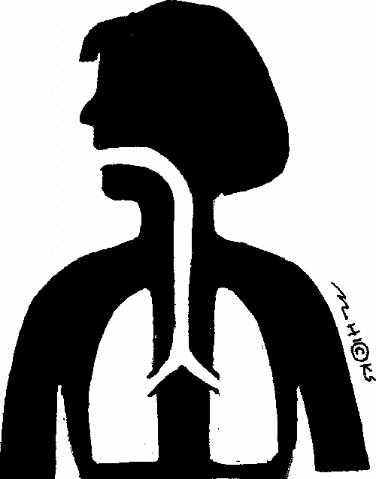
Respiratory Effects
Inhaling vapors from uncured resins may result in dryness and irritation of the respiratory tract.
More harmful effects are possible if basic safety precautions are disregarded.
If vapors are inhaled, move victim to fresh air and obtain professional medical attention.
This is unlikely to occur with the Formlabs system, but be aware!

Slide 35
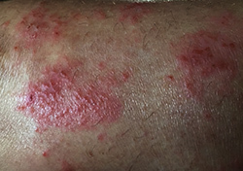
Skin Effects
Skin irritation may take the form of redness and itching; there may also be slight blistering. Some people experience a condition that looks very similar to poison ivy.
The degree of reaction will vary according to the amount of exposure and the sensitivity of the individual; most people will be unaffected by contact, but some can have severe reactions. Your reaction can change over time.
If skin rashes occur, determining the source of the exposure and implementing the required prevention should be given top priority. Make sure impervious gloves are worn when handling.
Remove and dispose of contaminated clothing and wash affected skin areas thoroughly with mild non-abrasive soap and lots of lukewarm water. Flush affected area with lukewarm water for 15 minutes.

Slide 36
Chemical Sensitization
Sensitization occurs when the body has an allergic response, usually triggered by exposure to a much smaller quantity of the material than is necessary to cause skin irritation.
Some people may develop sensitization over a period of time.
A typical sensitized response to acrylates is a mild itchy rash, but can be severe enough to cause swelling of the face, typically around the eyes.
In some individuals, the reaction can resemble an asthma attack.
Persons exhibiting sensitization symptoms should see a physician (allergist, dermatogist). It is likely that sensitized persons will be advised to avoid further exposure to acrylates.
Sensitization is a permanent condition and can lead to other chemical sensitivities.
Do you have a latex allergy or other chemical sensitivity? You may want to talk to your doctor about acrylates.
More info at: https://www.dermnetnz.org/topics/allergy-to-acrylate/

Slide 37
Housekeeping - Contain
Keep work area clean.
Use absorbent rags to clean spills/drops/wet touches immediately.
Wipe with isopropyl alcohol (IPA).
Use the provided, labeled container for all trash disposal.
Dispose of rags and gloves properly. (Bag, seal, place in labeled container.)
Do not touch shared items (door handles, etc.) with contaminated gloves.
Cured resin is not an issue and can be put directly into the trash.

Slide 38
Storage and Disposal – Cure or Contain
Storage:
Store sealed containers at 50 – 95 F in the designated areas.
Disposal:
Properly cured resins are not considered hazardous wastes.
Dispose liquid resins in designated and clearly labeled acrylate waste containers/tanks.
Double bag contaminated gloves, rags, etc.
Items with small drops of uncured resin can be cured under the UV light and then put in the regular trash.
Notes:
The Formlabs resin can be cured with a laser or a UV light.
There are some special concerns around the use of this light that need to be addressed.

Slide 39
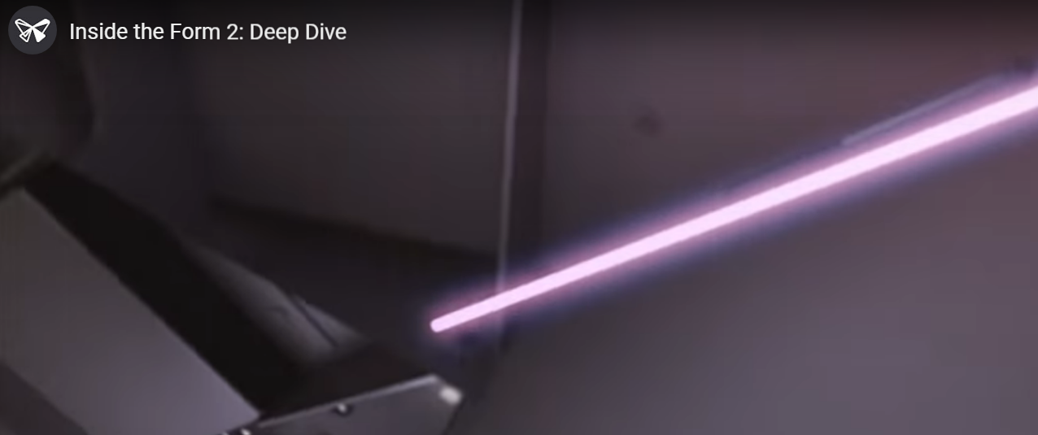
Laser Issues
The Form 2 has a Class 1 UV Laser.
405 nm wavelength radiation:
This can cause tanning and mild burns to the skin and eyes.
The laser beam is harmful to the eyes, so avoid direct contact.
Never remove the front or back panels of the printer. This will expose you to danger.
The Form 2 contains an interlock system to automatically shut off the laser when the orange cover is opened. If this system is tampered with, or fails, there is risk of exposure.
Risk is very low if system isn’t bypassed

Slide 40
UV Exposure Cautions
make 717 has an overhead UV light to help with curing of excess resin.
UV lights can cause burning to skin and eyes.
Needless exposures should be avoided, even in cases in which the eyes and skin are covered. Always use appropriate PPE.
The UV lamp should never be viewed directly.
Note when the warning sign is on and avoid the UV light.
Take all necessary steps to reduce the exposure time

Slide 41
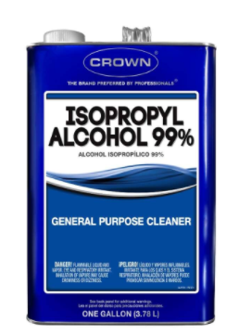
IPA Handling
Isopropyl Alcohol (IPA) is highly flammable
Keep away from heat, sparks, etc.
Wear nitrile gloves and splash goggles when handling, esp. pouring.
Use in well ventilated spaces – Fumes!!
If you get a headache or feel nauseous, there is probably not enough ventilation – move out of the space and get some fresh air!
Keep containers closed when not in use – Fumes!
Use of contact lenses if there is a risk of splashing is not recommended!
Don’t use IPA to clean resin off your skin – it will only make it enter your body more quickly!

Slide 42
Contaminated IPA Handling
Any IPA that has been used to clean resin is contaminated and is considered to be hazardous waste.
DO NOT POUR DOWN A SINK!!
All contaminated liquid needs to be collected in the specified container, and will be transferred by make 717.

Slide 43
Resources
Formlabs: https://formlabs.com/
Formlabs safety Info: https://support.formlabs.com/s/article/Safety-form2?language=en_US
SDS classification system: https://www.era-environmental.com/blog/ghs-hazard-classification
Lancaster Solid Waste Management Authority: https://www.lcswma.org/

Slide 44
Form 2 Print Process
Sam Bischel, make717 Innovation Center

Slide 45
Post Processing parts
After a print is completed, the part needs to be washed and cured to ensure that no uncured resin is spread. Formlabs has a very straight forward system that make717 uses to make it much simpler to use. Make717 has the Formlabs Form Wash and Form Cure to simplify the post processing workflow.

Slide 46
Operation Workflow
Close the barrier behind you
Put on gloves
Cover the Print desk with plastic wrap
Lay out tools
Press the button on the wash station to open the wash station
Open the Form 2 lid and remove the build plate

Slide 47
Operation Workflow
Wash the part in the wash station
Wash the whole build plate, or
Remove part if someone needs the build plate
Remove plate from wash and part from plate
Trim supports while print is semi-soft
Transfer part to cure station
Turn on and run cure

Slide 48
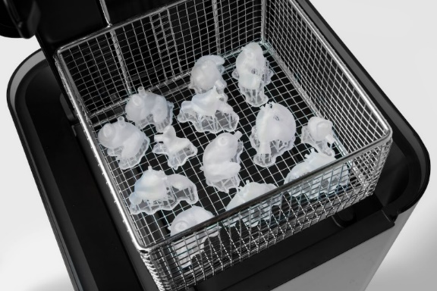
Washing Parts
The easiest thing to do is
to put the build plate into
the Form Wash without
removing the parts. This
is especially recommended
if you have smaller parts. You can also remove the parts if someone is waiting to use the machine as shown. The Build plate should also be washed before changing resin types to reduce cross contamination between resin types.

Slide 49
Using the Form Cure
After the parts are washed and dried, they can be transferred to the Form Cure. This will ensure that the resin is brought up to the true physical properties. It also make sure any extra resin is cured. Parts need to be removed from the build plate and it is recommended to remove supports while the resin is in a softer state. The recommended cure times and temperatures are posted next to the Form Cure.

Slide 50
Using the Form Cure
Once the parts are inserted into the Form Cure, you can start the curing process. If you are using the heat function, it will preheat the chamber to the set temperature. It is recommended by formlabs to not “preheat” the chamber before putting parts in it since it may cause cracking.

Slide 51
Recommended cure settings are on the wall

Slide 52
Formlabs Practical Test
make717 Innovation Center

Slide 53
Operation Workflow
Put on gloves
Cover the desk with plastic wrap
Lay out tools
Open the wash station
Open the demo lid and remove the build plate
Remove the part from the plate
Place in wash station and rinse
Clean up
Remove gloves

Slide 54
Formlabs Basics Training
Sam Bischel, make717 Innovation Center

Slide 55
Safety
Please follow the list of contact numbers and if necessary, enter these numbers into your phone.
Emergency- 911
TSCT Security-(717)606‐1564
PA State Police-(717)299‐7727

Slide 56
Safety Continued
As seen in your acrylate training, the resin, alcohol, and laser are all very dangerous in separate ways. Exercise extreme caution when using this machine. Misuse will not be tolerated as it is a danger to others around you.

Slide 57
Form 2 Printer
Make 717 has one Formlabs Form 2 named Literate Seal.
The Form 2 has many features that other SLA printers in its class do not in order to make the machine safer. Please do not try to bypass these safety measures. They are there for your own benefit.

Slide 58
Preform Introduction
Preform™ is the slicer used with the Form 2. While similar to slicers like Cura or Simplify 3d, it is not the same program. Preform™ is the only program that may be used with the Formlabs.

Slide 59
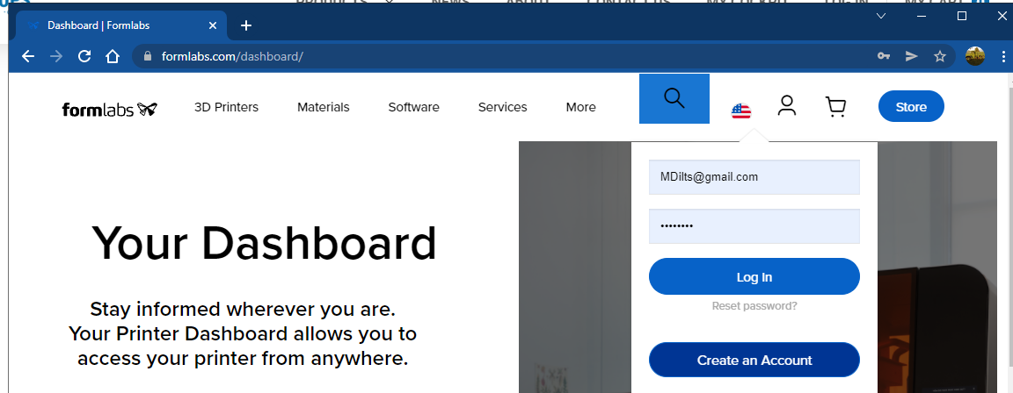
Make an Account
https://formlabs.com/dashboard/

Slide 60
Preform™
Select the printer here, our printer is named Literate Seal, you will have to be on our network to see it on the list. If you are using Preform from home, you can save a .form file to open it at make717

Slide 61
Preform
You will also have to pick which resin you have. MAKE SURE YOU SELECT THE CORRECT VERSION AS WELL. The printer will not print like a traditional FDM printer and use whatever it has in it because each resin and version need to be cured differently.

Slide 62
Preform
Your workspace should look like this. You can always edit the resin and layer settings in the printer menu.

Slide 63
Preform
Open a file using the File, open option or Ctrl-O

Slide 64
Preform
Right away, you will see there are warning with the imported model, These warnings can be ignored at your own risk but are important to be acknowledge before sending the job to the printer. Any error shown in red should be considered aa risk to the print and the printer if nowt fixed. Fix any errors in red if one comes up.

Slide 65
Preform
Scaling menu works the same as in Cura or Simplify 3d. All scaling is done at a 1.0% basis. Scaling to 100 will result in a 100 times larger part.

Slide 66
Preform
Clicking Auto orient all is the best solution to most of the errors thrown by Preform. This may not look like the best orientation but will eliminate wear on the machine.

Slide 67
Preform
Auto generating supports also helps with any errors and are always needed after an Auto Orient All move.

Slide 68
Preform
Because we have now gone through all of these items, all of the checks for printability are passed and is ready to be sent to the printer.

Slide 69
Preform
If you have multiple objects, this feature acts like center and arrange in Simplify.

Slide 70
Form 2 Preparation
Once the print file has been uploaded, you can now glove up and start working with the printer.

Slide 71
Form 2
If the Form 2 has a print already on the plate, use the jig to hold the platform and scrape the plate off and wash the part.

Slide 72
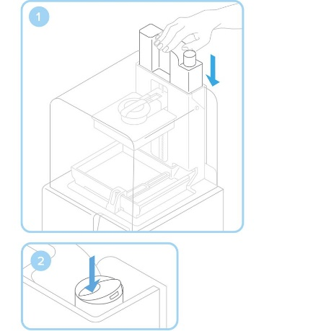
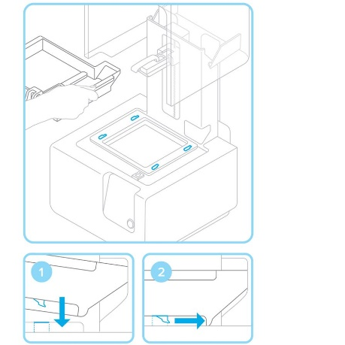
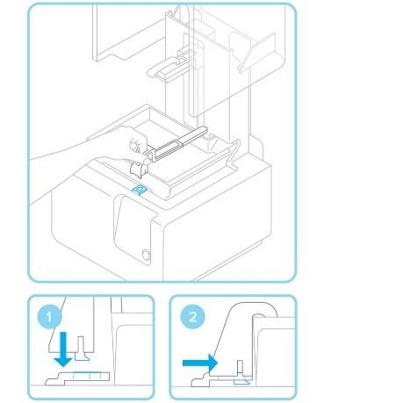
Setting up the Form 2
Insert the build platform is not already attached
Insert correct resin cartridge and open breathing valve. The printer will read and confirm the new resin tank
Insert the resin tank and wiper. If the printer does not confirm the new tank, clean the contacts with isopropyl alcohol and reinsert the tank
Lock the Wiper blade as shown

Slide 73
Setting up the Form 2
Insert the build platform if not already attached
Insert correct resin cartridge and open breathing valve. The printer will read and confirm the new resin tank
Insert the resin tank and wiper. If the printer does not confirm the new tank, clean the contacts with isopropyl alcohol and reinsert the tank
Lock the Wiper blade as shown

Slide 74
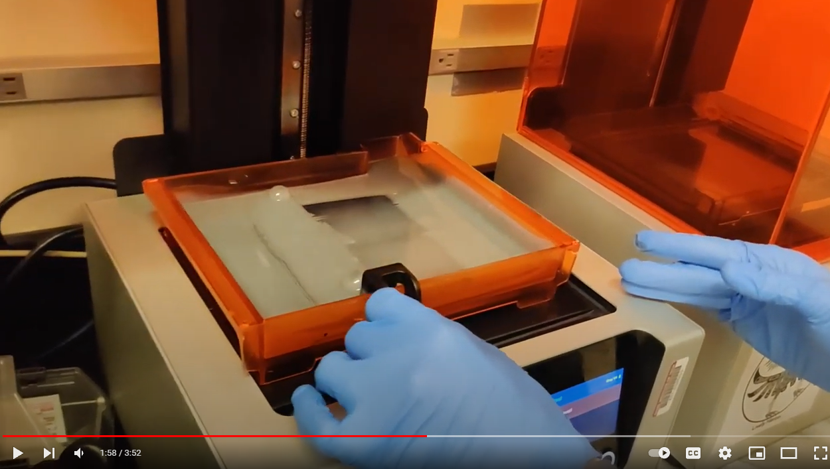
Changing a resin Tank

Slide 75
Setting up the Form 2
Once the tank and cartridge are inserted, they will start to heat before the print starts. This typically takes awhile and may take longer if the tank needs to be filled. Let the printer fill the tank so it does not over fill.

Slide 76
Setting up the Form 2
Once the tank, build plate, and cartridge are inserted, you can start the print. It will ask you to confirm the breathing valve is open and nothing is on the build plate. After you confirm this, it will either finish heating or filling the tank and start the print.

Slide 77
Formlabs Dashboard
Formlabs Dashboard is a way to monitor the Formlabs's progress. While you can send prints remotely, it is forbidden to do so since you are not there to monitor the prestart procedure.
At this point, you should already have an account with formlabs and are ready to join a group

Slide 78
Formlabs Dashboard
Login using your premade username and password

Slide 79
Formlabs Dashboard

Slide 80
Formlabs Dashboard

Slide 81
Formlabs Dashboard

Slide 82
Appendix – SDS
Details for all sections

Slide 83
Terms
Acrylates: the salts, esters, and conjugate bases of acrylic acid and its derivatives. (Wikipedia)
Monomer: unit molecule used to build up polymers.
Polymer: a large molecule made up of many subunits. A common term is “plastic.”
Copolymer: a mixture of 2 polymers that creates a new substance with unique properties
SDS: Safety Data Sheet

Slide 84
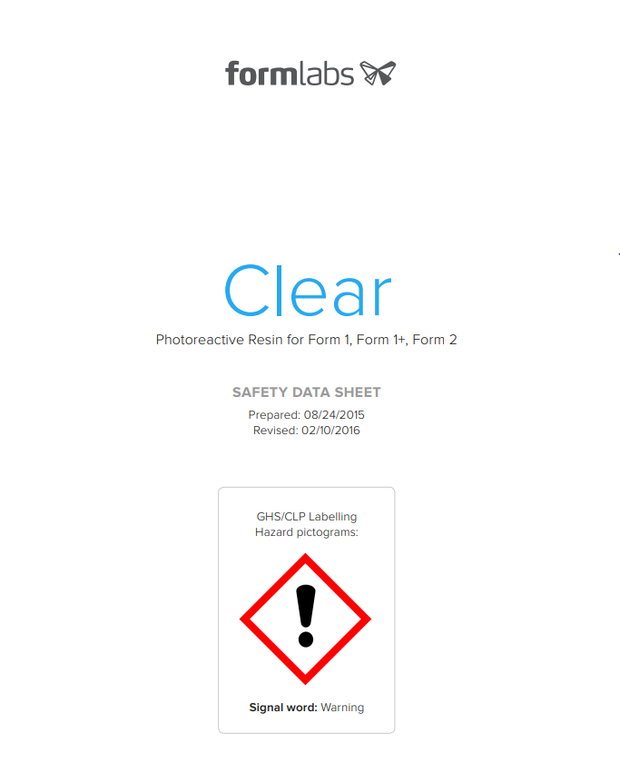
SDS make 717 policy
All chemicals in the make facility have an SDS on file
Read the SDS before you use a new-to-you chemical!
Any new chemicals brought to the site, must have an SDS submitted and approved before it can be brought on site

Slide 85
How to read and understand the SDS for Formlabs resin
This section is a high level review of the safety data sheet for Formlabs acrylic resin and its implications for use in the make 717 facility.

Slide 86
SDS for Formlabs acrylates
The formalabs materials are “photoreactive” – they start to have a chemical reaction when exposed to light
Methacrylic acid esters – therefore they must be treated as Acrylates

Slide 87
SDS for Formlabs acrylates
This part of the SDS summarizes at a high level the hazards :
Skin irritant
Skin or respiratory sensitizer (ie., exposure makes you allergic – think peanuts)
Eye irritant

Slide 88
SDS for Formlabs acrylates
More details about specific hazards and how to handle safely:
Skin irritant = wear gloves, wash after handling
Wear eye and/or face protection
Special containment to avoid releasing into the environment
Contaminated clothing can’t leave the work site!!!
This is NOT PLA!!!

Slide 89
SDS for Formlabs acrylates
More details about how to handle safely:
Wash well
Seek medical attention if a rash forms
Collect any stray spills and contaminated good
Other health effects
headaches, nausea, etc.

Slide 90
SDS for Formlabs acrylates
Section 3 gives the chemical information

Slide 91
SDS for Formlabs acrylates
Section 4 gives the First Aid information. You should always read this (read it first even!)
What to do in case of an incident: inhalation, resin in eye, resin on skin, ingestion

Slide 92
SDS for Formlabs acrylates
Section 5 gives the Fire Fighting information.
Flash point is 200F, but the resin doesn’t ignite
Carbon Dioxide or dry chemical fire extinguisher needed

Slide 93
SDS for Formlabs acrylates
Section 6 gives the info on what to do if you have spill. Read and understand this!!
DO NOT flush resin down the drain!!!
Need a dedicated trash container for anything that gets contaminated!

Slide 94
SDS for Formlabs acrylates
Section 7 gives the info on handling and storage
Use in a well ventilated area
Contaminated clothes can be washed (by themselves), but soft leather goods need to be destroyed. However, to limit exposure to others, make 717 suggests the clothes to be disposed of before leaving the work area if at all possible. Layers are suggested.
Keep out of direct sunlight
Store at temperatures between 50 and 95F.
This is NOT PLA!!!

Slide 95
SDS for Formlabs acrylates
Section 8 gives exposure limits and controls
No limit to how long you can use it, provided you don’t have an acrylate issue

Slide 96
SDS for Formlabs acrylates
Section 8 con’t
Well ventilated area
Nitrile or Neoprene gloves for handling
Splash goggles
Wear long sleeves – consider a lab coat or disposable apron

Slide 97
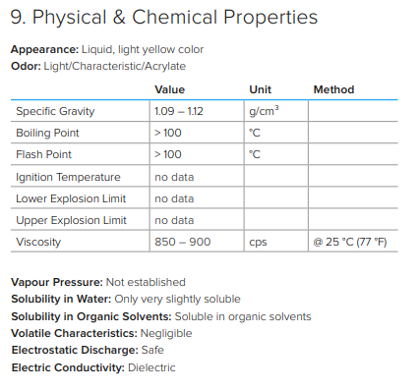
SDS for Formlabs acrylates
Section 9 – physical and chemical properties
Boiling point
Flash point
No electrostatic discharge
Not soluble in water
Soluble in organic solvents

Slide 98
SDS for Formlabs acrylates
Section 10 – Stability and Reactivity
Store in the original container, out of light, and below 100F
Keep away from alcohols, hydrogen peroxide, copper and copper alloys, carbon steel, iron, rust and strong bases (ammonia)

Slide 99
SDS for Formlabs acrylates
Section 11 – Toxicology info
Beyond the scope of what we worry about

Slide 100
SDS for Formlabs acrylates
Section 12 – Environmental impacts
Not biodegradable
Don’t put into the drains!

Slide 101
SDS for Formlabs acrylates
Section 13 – Disposal
Contact a licensed professional disposal service to dispose of the uncured resin!!!!
The good news – we can take it to the LCWMA transfer station, but only in small quantities
Don’t put into the drains!
Contaminated packaging, etc.: expose to light to cure and then dispose

Slide 102
SDS for Formlabs acrylates
Section 14 – Transporting
Not pertinent

Slide 103
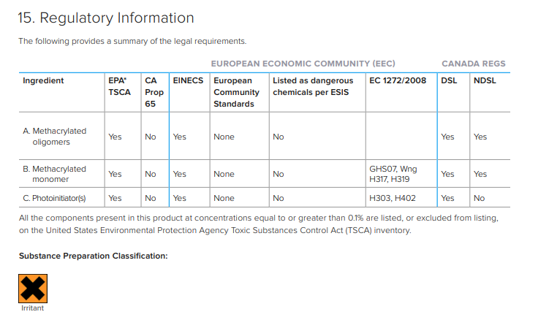
SDS for Formlabs acrylates
Section 15 – Regulatory info
Lists any regulations related to the components
Classified as an Irritant

Slide 104
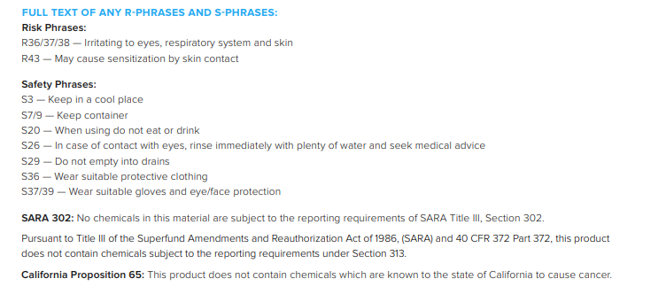
SDS for Formlabs acrylates
Section 15 – con’t
Do eat or drink when using
May cause sensitization via skin contact
Wear PPE

Slide 105
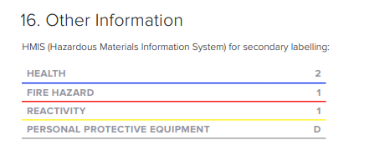
SDS for Formlabs acrylates
Section 16 – Other info
Other safety classifications

